Slide 1
Mini project 2 general tips

Slide 2
Are boundaries included in model?
Ghost point
dx
c_right
c_left
c[0]
c[1]
c[-1]
Dirichlet method 1: dcdt[0] = 0 and c0[0] = boundary value at edge of domain (included by dx/2)
Dirichlet method 2: dcdt[0] = D $\frac{c_{left} − 2c\left[0\right] + c[1]}{dx^{2}}$ and c0[0] = 0. Boundary value 1 dx outside domain.
Method 2 is shifted 1 dx left compared to method 1
Which method gives the highest concentrations in the model domain??

Slide 3
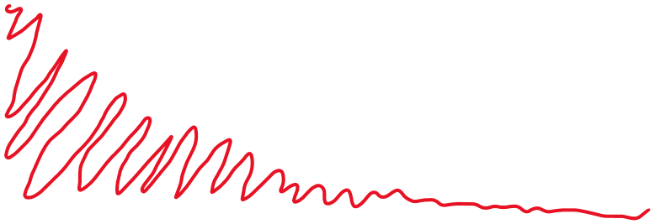
Calculating total mass in system
O2
np.trapz(O2, x_grid) = area under curve
(total O2 in model domain)
x
c[0]
c[1]
c[-1]
dx
This should give the same as: np.sum(O2[1:-2] * dx) + np.sum(O2[0, -1] * dx/2)
Output is O2 mass unit / area unit.
If you want O2 in the whole tank → multiply by the surface area of the tank

Slide 4


Does calculating total mass in domain verify that you have model conservation?
Calculate flux in and flux out of domain → does it equal the mass in the system?
$$J_{in}=−D\frac{dc}{dx}$$
$$J_{out}=−D\frac{dc}{dx}$$
c[0]
c[1]
c[-1]
Flux is instant at some x position [g/m2/s]
Cumulative flux unit = [mass/area].
Cumulative flux → integrate fluxes with respect to time → np.trapz(fluxes, time)
$$J_{in_cum}−J_{out_cum}=accumulated in system without reaction$$

Slide 5
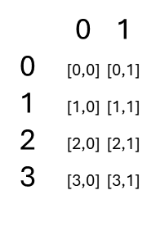
Handling 2 state variables
Flatten method was good for 2D arrays. It also works for 1D, but output is not that intuitive
The 2D case
The 1D case with two state vars
r
State variables
0 1 2 3
0 [0,0] [0,1] [0,2] [0,3]
1 [1,0] [1,1] [1,2] [1,3]
2 [2,0] [2,1] [2,2] [2,3]
3 [3,0] [3,1] [3,2] [3,3]
Before flatten:
z
z
r = 0
r = 1
r = 2
r = 3
[0,0]
[0,1]
[0,2]
[0,3]
After flatten:
z = 0
State variable 1
State variable 2
[0,0]
[0,1]
[1,0]
[1,1]
[2,0]
[2,1]
[3,0]
[3,1]
z = 0
State variable 1
State variable 2
z = 1
[1,0]
[1,1]
[1,2]
[1,3]
State variable 1
State variable 2
z = 2
z = 1
State variable 1
State variable 2
z = 3
[2,0]
[2,1]
[2,2]
[2,3]
z = 2
Inspect and identify what rows and columns through the
variable explorer to make sure you understand it.
Output from solve_ivp() gives time along the columns!
[3,0]
[3,1]
[3,2]
[3,3]
r = 3

Slide 6
Alternative
See group exercise 6 solution under 09_23_sept
Use of np.concatenate()
O2 = np.zeros(len(x_grid)) = [0,0,0,0,0,0…]
OM = np.zeros(len(x_grid)) = [0,0,0,0,0,0…]
C0 = np.concatenate([O2, OM]) = [0,0,0,0,0,0…0,0,0,0,0,0…]
O2
OM
State variable 1
State variable 1
z = 0
z = 1
Output from solve_ivp()
State variable 1
State variable 1
z = 2
z = 3
State variable 2
State variable 2
State variable 2
State variable 2

Slide 7
Modular approach
Script approach
Script running model
Script with model
Load libraries
Load model
Call model with different input values
Plot model predictions
Load libraries
Define input values
Rates()
Solve_ivp()
Plot and inspect solve_ivp() output
Model()
Rates()
Solve_ivp()
return dictionary
Difficult to debug
Easy to debug

